Slide 1
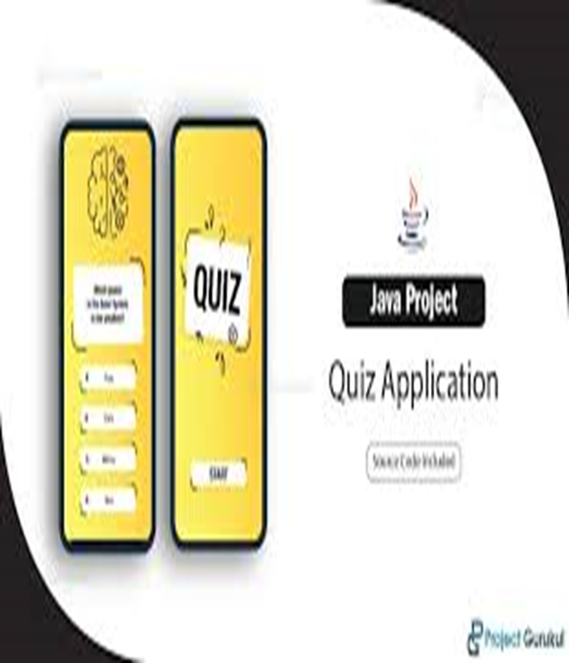
Building a Quiz Application with Java and Swing
Project members-
SUMIT SINGH RANA
ABHISHEK RANA
VAIBHAV CHAUHAN

Slide 2
Introduction
Designing the User Interface: We'll design the layout of our quiz application using Swing components such as labels, buttons, and radio buttons.
Implementing the Quiz Logic: We'll create the logic to load questions from a data source (such as a text file or a database), display them to the user, and handle user input for selecting answers.
Scoring and Feedback: We'll implement scoring logic to calculate the user's score based on their answers and provide feedback on their performance, such as displaying the correct answers and the user's score.
Adding Features: Depending on the complexity of the application, we can add features such as a timer, difficulty levels, or the ability to save and load quiz progress.
Testing and Refinement: Finally, we'll test the application thoroughly to identify and fix any bugs or usability issues. We'll also refine the user interface and functionality based on feedback.

Slide 3

OBJECTIVE OF THE PROJECT
The objective of the quiz application using Swing and Java is to:
Create an Interactive User Interface:
Leverage Swing components (JFrame, JPanel, JLabel, JButton, JRadioButton) to build a responsive and user-friendly interface.
Manage Quiz Logic:
Implement classes to represent questions, track quiz progress, and manage scoring.
Handle User Interactions:
Capture and process user inputs using event listeners to provide real-time feedback and update the quiz state dynamically.
Enhance Learning and Engagement:
Provide an engaging platform for users to test their knowledge and receive immediate feedback, enhancing the learning experience.

Slide 4
COMPONENTS
Question Class
Represents an individual quiz question.
Stores question text, options, and the correct answer index.
Quiz Class
Manages a collection of Question objects.
Keeps track of the current question index.
GUI Using Swing
Main Frame: The main window of the application.
Question Panel: Displays the current question and options using J Label, J radio Button, and Button Group.
Controller Class
Manages the interaction between the Quiz model and the Main Frame view.
Handles user input and controls the quiz flow.

Slide 5
QUESTION CLASS
Fields
questionText: A String that holds the text of the question.
Example: "What is the capital of France?“
options: An array of String containing the possible answer choices.
Example: {"Paris", "London", "Berlin", "Madrid"}
correctOptionIndex: An int representing the index of the correct answer in the options array.
Example: 0 (indicating "Paris" is the correct answer)

Slide 6
QUIZ CLASS
The Quiz class is a core component that manages the flow of the quiz. It holds the
list of questions, tracks the current question index, and maintains the score.
Fields
questions: A List<Question> that stores all the quiz questions.
Example: List<Question> questions
Current Question Index: An int that tracks the index of the current question being displayed.
Example: int currentQuestionIndex
score: An int that keeps track of the user's score.
Example: int score

Slide 7
SWING COMPONENTS
Key Swing Components
JFrame
Purpose: Main application window, the container for all other components.
JPanel
Purpose: Container to organize components within the JFrame.
JLabel
Purpose: Displays text, such as the quiz question.
JButton
Purpose: Clickable button for actions like submitting answers.
JRadioButton
Purpose: Represents a selectable option for multiple-choice answers.
ButtonGroup
Purpose: Groups JRadioButtons to ensure only one option is selected at a time.

Slide 8
Displaying Questions and Options
Initialize Components:
JLabel: Displays the question text.
JRadioButton: Represents answer options.
ButtonGroup: Ensures only one option can be selected at a time.
JButton: Used for submitting answers.
Arrange Components:
Use JPanel with layout managers
Add the question label at the top, option buttons in the center, and submit button at the bottom.
Handling User Interactions
Event Listeners: Attach listeners to buttons to handle user actions, such as submitting an answer.
Example: Use ActionListener for the submit button to capture and process user input.

Slide 9
GUI Interaction with the quiz and controller classes
Overview of Interaction:
The GUI interacts with the Quiz and Controller classes to facilitate user engagement and quiz progression.
User Input Handling:
When a user interacts with the GUI (e.g., clicks a button representing an option), the Controller class captures
the event.
Updating the GUI:
Upon receiving input from the user, the Controller class updates the GUI accordingly.
4.Flow Diagram:
Visual representation of the interaction flow between the GUI, Controller, and Quiz classes.
Clarifies the sequence of events from user input to GUI update.
5.Code Snippet:
Highlight a relevant section of code demonstrating how the GUI interacts with the Controller and Quiz classes.
Emphasize the communication mechanisms used, such as method calls or event handling.

Slide 10
Conclusion
In this presentation, we've walked through the development of a quiz application using Java and Swing. By combining Java's backend functionality with Swing's graphical user interface components, we've created an engaging and interactive learning tool.
Throughout the demonstration, we've highlighted how the GUI seamlessly interacts with the Quiz and Controller classes, enabling users to navigate through questions, provide answers, and receive immediate feedback.
This integration ensures a smooth and enjoyable user experience, fostering active participation and knowledge retention. Beyond its educational value, this quiz application demonstrates the versatility of Java and Swing for creating desktop applications.
Its modular design allows for easy customization to fit various subjects, difficulty levels, and learning objectives. Furthermore, it can be adapted for training, assessments, or recreational purposes, showcasing the broad range of applications these technologies offer.
As we conclude, we encourage further exploration and experimentation with Java and Swing to unleash the full potential of desktop application development. Thank you for joining us on this journey, and we look forward to seeing the innovative applications you create.

